Slide 1
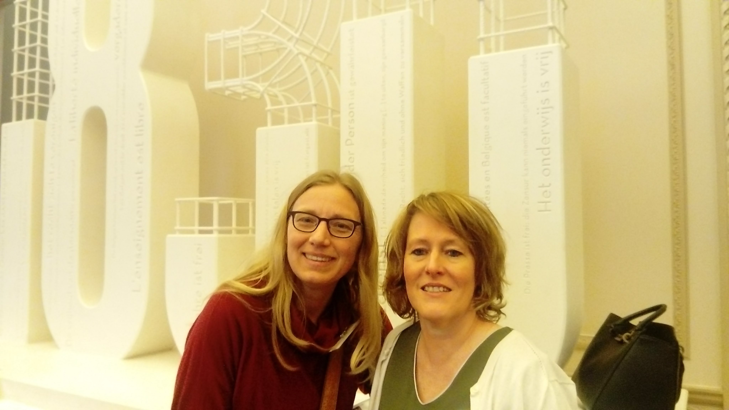

REPEAT THE 4 PILLARS!

Slide 2
1. 3 keywords to characterize yourself
Sum up the typical characteristics of the inhabitants of your country.

Slide 3
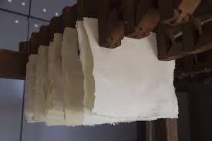
For example: the Dutch are stingy.
Jokes like: they hang their toilet paper out to dry.

Slide 4
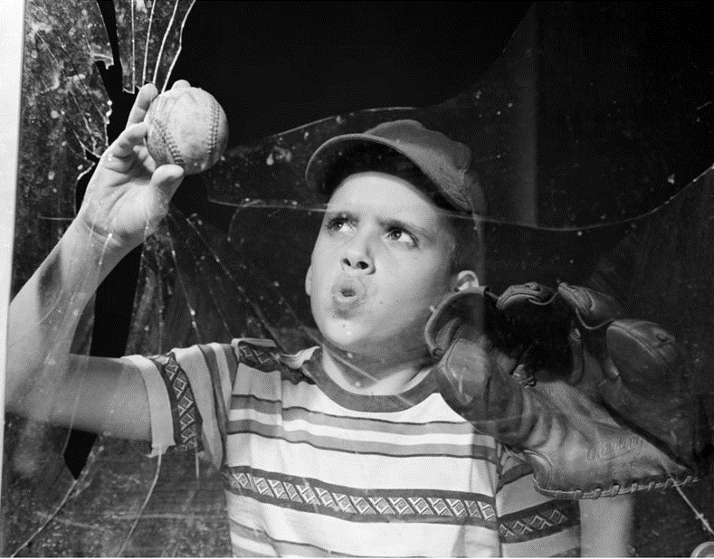
FRAMES AND FRAMING
1. 3 keywords to characterize yourself
2. Sum up the typical characteristics of the inhabitants of your country.
For example: the Dutch are stingy.

Slide 5

Often negative frames!

Slide 6
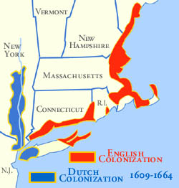
Why do we say the Dutch are stingy?
Cultural explanations -> protestants
Theories -> Montesquieu
Historical explanations -> rivalrie

Slide 7
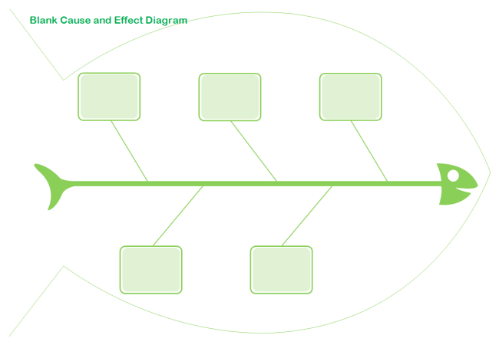
SYSTEMIC CAUSALITY
Why do we say the Dutch are stingy?
Cultural explanations
Theories
Historical explanations

Slide 8
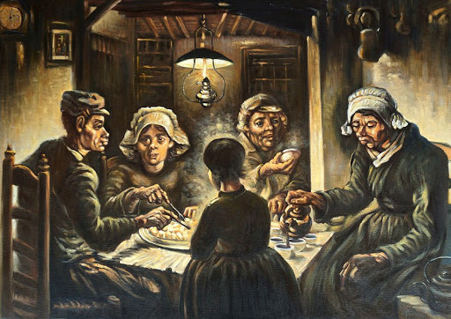
The patato eaters, Van Gogh

Slide 9
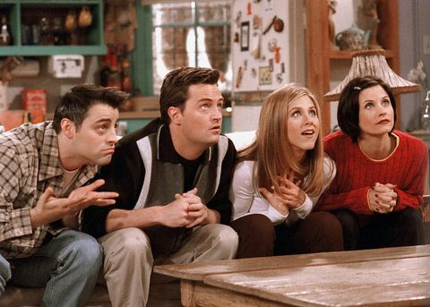

Slide 10
EMPHASIS FRAMES
The patato eaters, Van Gogh

Slide 11


Slide 12
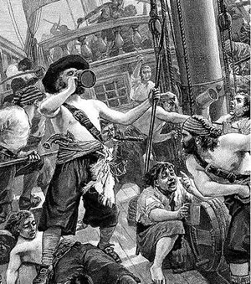


Slide 13
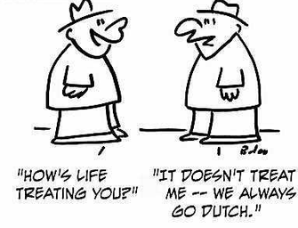

Slide 14


MOTIVATED COGNITION

Slide 15


Slide 16
